Slide 1

Mediation 3.0
Scalable parallel CDR processing

Slide 2
A bit of history
Mediation 1
jBilling version | 1.1.0
Release date | November 27, 2007
Based on | Drools
Pros | Nice separation between reading records and processing records. Generic rules engine with own GUI, tools, language
Cons | 1) Very slow 2) Steep learning curve for Java developers
CDRs per second | 10 to 20

Slide 3
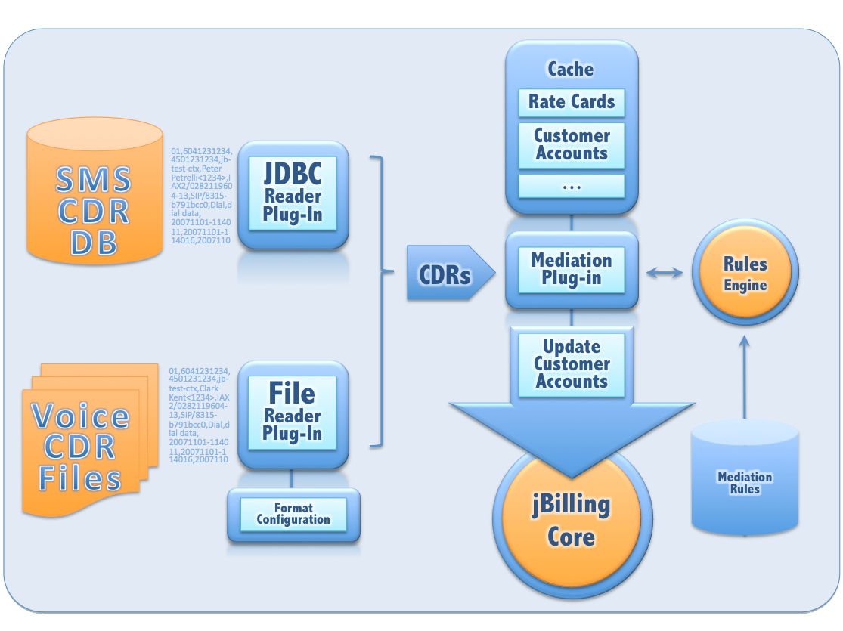

Slide 4
A bit of history
Mediation 2
jBilling version | 3.0.0
Release date | February 9, 2012
Based on | Java
Pros | Easy to understand for Java developers Maintains same design and configuration as v1.
Cons | As fast as 1 core can handle: single threaded.
CDRs per second | 30 to 60
Notes:
Grails is meant for good design, not speed

Slide 5
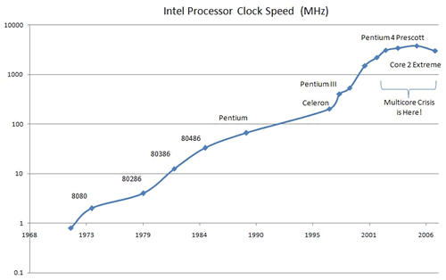
Computing Resources
CPUs are not getting faster… but they are multiplying.

Slide 6
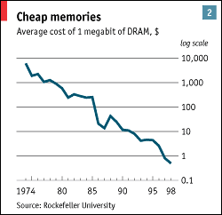
Computing Resources
Memory is getting consistently cheaper.

Slide 7


Cloud Computing
Small 2 CPU 4 GB RAM
Small 2 CPU 4 GB RAM
Small 2 CPU 4 GB RAM
Medium 8 CPU 16 GB RAM
Dynamic allocation of computing resources: RAM and CPUs (number)

Slide 8
Taking advantage of these trends
Trend
Lots of RAM
Slow CPUs, but many
Cloud computing
Cache
Fast RDBMS server
Parallel processing
Distributed processing
Allocate resources when needed
Submit mediation jobs to cloud cluster
Notes:
Grails is meant for good design, not speed

Slide 9
Hadoop
Framework for parallel, distributed processing
Hadoop Cluster
jBilling
Server
CDRs for processing
Hadoop node
Hadoop node
Hadoop node
Hadoop node
Hadoop node
Elastic MapReduce
jBilling
Server
Hadoop Job
EC2
API

Slide 10
Hadoop
One of Yahoo's Hadoop clusters sorted 1 terabyte of data in 209 seconds, which beat the previous record of 297 seconds in the annual general purpose (daytona) terabyte sort benchmark. The sort benchmark, which was created in 1998 by Jim Gray, specifies the input data (10 billion 100 byte records), which must be completely sorted and written to disk. This is the first time that either a Java or an open source program has won.
The cluster statistics were:
910 nodes
2 quad core Xeons @ 2.0ghz per a node
4 SATA disks per a node
8G RAM per a node
1 gigabit Ethernet on each node
40 nodes per a rack
8 gigabit Ethernet uplinks from each rack to the core
Red Hat Enterprise Linux Server Release 5.1 (kernel 2.6.18)
Sun Java JDK 1.6.0_05-b13

Slide 11
Mediation Goal
A call detail record is produced by a switch when a phone call ends
The CDR needs to be translated to billing terms
The jBilling database is updated with the charges
Guide to account
10000,4033211001,4501231235,"jb-test-ctx","Rate Card Test 5 <1234>","IAX2/0282119604-13","SIP/8315-b791bcc0","Dial","dial data","20071101-110325","20071101-110355","20071101-111530",1,60,"ANSWERED",3,"mediation-batch-test-08"
jBilling DB
Determine date
Resolve a product
Resolve the quantity
Price it
Notes:
This is the type of application that we are going to be talking about: a typical enterprise app done with Grails.

Slide 12
Mediation Architecture
A call detail record is produced by a switch when a phone call ends
The CDR needs to be translated to billing terms
The jBilling database is updated with the charges
jBilling RDBMS
10000,4033211001,4501231235,"jb-test-ctx","Rate Card Test 5 <1234>","IAX2/0282119604-13","SIP/8315-b791bcc0","Dial","dial data","20071101-110325","20071101-110355","20071101-111530",1,60,"ANSWERED",3,"mediation-batch-test-08"
Hadoop Cluster
Spring Data
Spring Batch
HBase
Event

Slide 13
JMR
jBilling Mediation Record or JMR in short, is a new entity/class in jBilling which represents the bare minimum data that jBilling needs to mediate or charge an event.
jBilling User ID
jBilling User's Currency ID
Event Date or Mediation Event Date
jBilling Item or Product ID (Required to create the Order)
Quantity to be charged
Event Description
Pricing Fields Data (for Pricing Rules)
Record Key

Slide 14
Mediation Architecture
CDR
JMR
DB
The CDRs are copied to HDFS
The Mappers convert the CDR to JMR using a series of steps
The Reducer receives JMRs for one user
The Reducer processes the JMR, updating the DB

Slide 15
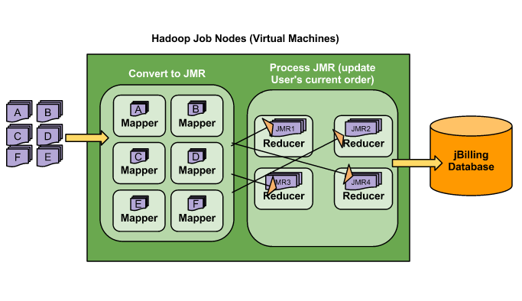
Mediation Architecture

Slide 16
Mediating a new source of CDRs
CDR Source
Place CDRs in HDFS
Describe the record
Processing
Create Steps java objects to convert the CDR to JMR
Configure the system to use those objects
We should forget about small efficiencies, say about 97% of the time: premature optimization is the root of all evil.
- Donald Knuth

Slide 17
CDR Source
Place CDRs in HDFS
This is configured through Spring Batch tasklets in the grails resources.xml file
Spring Batch allows for any number of pre-processing steps: copy file, sorting, splitting, etc.
The Hadoop processing is just a step in many batch steps

Slide 18
CDR Source
Describe the record
This is configured through Java beans in the hadoop-resources.xml file.
BasicMediationRecordLineConverter
Format
Tokenizer separator = ‘,’
FormatFields
Descriptor file = ‘asterisk.xml’

Slide 19
Steps Design
A Step is a Java class that can be chained with other steps. A chain of steps is what the Mapper does to convert a CDR to JMR
IMediationStep
interface
AbstractMediationStep
Class
UserMetafieldResolutionStep
Class
A Step gets called its‘executeStep’ method, which receives a ‘MediationResult’ object. The step goal is to set some of the MeidationResult attributes.

Slide 20
Steps Development
boolean executeStep(Integer entityId, MediationStepResult result, List<PricingField> fields)
Integer entityId: The company ID this mediation is running for
MediationStepResult result: The JMR
List<PricingField> fields: The CDR
Return value: true is OK, false is error
A Step gets called its‘executeStep’ method, which receives a ‘MediationResult’ object. The step goal is to set some of the MeidationResult attributes.

Slide 21
Steps Configuration
Guide to account
Spring Configuration
Determine date
Resolve a product
Resolve the quantity
Hadoop-resources.xml
Price it
Each step is a class that extends AbstractMediationStep

Slide 22
Steps Configuration
<bean id="userLoginResolverStep" class="com.sapienter.jbilling.server.mediation.step.user.UserLoginResolutionStep" >
<property name="usernameField" value="userfield"/>
</bean>
<bean id="eventDateResolverStep" class="com.sapienter.jbilling.server.mediation.step.eventDate.EventDateResolutionStep" />
<bean id="itemResolverStep" class="com.sapienter.jbilling.server.mediation.step.item.ItemResolutionStep" >
<property name="itemId" value="2800" />
</bean>
<!-- Mapping between mediation steps used in the example mediation task implementation -->
<util:map id="exampleMediationStepConfig" map-class="java.util.LinkedHashMap”>
<entry key="USER_CURRENCY" value-ref="userLoginResolverStep" />
<entry key="EVENT_DATE" value-ref="eventDateResolverStep" />
<entry key="CURRENT_ORDER" value-ref="currentOrderResolverStep" />
<entry key="ORDER_LINE_ITEM" value-ref="itemResolverStep" />
<entry key="PRICING" value-ref="pricingResolverStep" />
<entry key="ITEM_MANAGEMENT" value-ref="itemManagementStep" />
<entry key="DIFF_MANAGEMENT" value-ref="oderDiffManagementStep" />
</util:map>

Slide 23
Example
Process 200,000 asterisk CDRs in Amazon EC2 instances
jBilling server
Type: m3.xlarge
Cores: 4
RAM: 16GB
Mediation server
Type: cc2.8xlarge Cores: 32
RAM: 60GB
Postgres server
Type: hi1.4xlarge Cores: 16
RAM: 60GB

Slide 24
Results
Process 200,000 asterisk CDRs in Amazon EC2 instances
50 mappers + 50 reducer + 100K CDRs will clock at 280 CDR/s, (5:30mins)
50 mappers + 50 reducer + 200K CDRs will clock at 380 CDR/s, (8:45mins)
50 mappers + 60 reducer + 1M CDRs will clock at 490 CDR/s, (34min)
Both mapper and reducer have a fixed cost for start-up and that is somewhere from 40 to 50 seconds. This is because of the full spring context initialization which includes hibernate, caching etc.
The DB starts with a cold cache. This has a grater impact on EC2, which has slow IO.

Slide 25
Results
Process 200,000 asterisk CDRs in Amazon EC2 instances
We get about 15 CDR/sec per vCPU
We get about 30 CDR/sec per physical core
EC2 VMs cost: Mediation: 0.904 per hour DB: 1.477 per hour
500 CDRs per second = 1.8M per hour
Cost: $1.32 for 1 million CDRs

Slide 26
Conclusion: jBilling Mediation 3.0
Horizontal scalability
Virtually unlimited speed: tens of thousands of CDRs per second is possible
Implementation of mediation is limited to development of Step objects
The Steps developer does not deal with the complexity of parallel processing.
Hadoop and EC2 work very well together and provide very cost effective high volume CDR processing.

Slide 27

Thanks!
Vlade
Panche
Vikas

